Slide 1
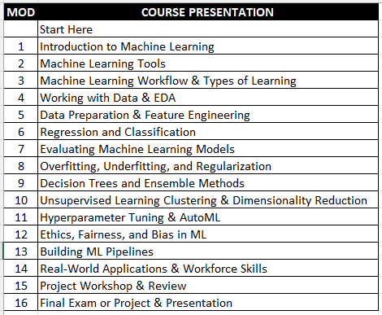
Introduction to Machine Learning
Class Syllabus Summer 2026 Modules
Revision 3.0
Machine Learning
Course
Presentation
Assignments
Key
Readings
Supplemental
Readings

